Slide 1
LogCat Health App
Hyland Hackathon project – LogCat Wizards

Slide 2
Team members and Mentors
Members
Adrishyantee Maiti
Samaresh Maiti
Shivam Shaw
Mentors
Swarnaprabha Ghosh
Kumar Gaurav

Slide 3
Project overview and features
An Android app to help Patients, Doctors and Vendors connect effortlessly.
Section where patients can find doctors available near them with their contact details.
It has a marketplace that allows users to go and the websites of available vendors so that they can buy necessary items.
A profile section where the details are displayed of the user/doctor/vendor).
A feed to discuss verified health related posts.
A tracker to check one’s daily health.

Slide 4
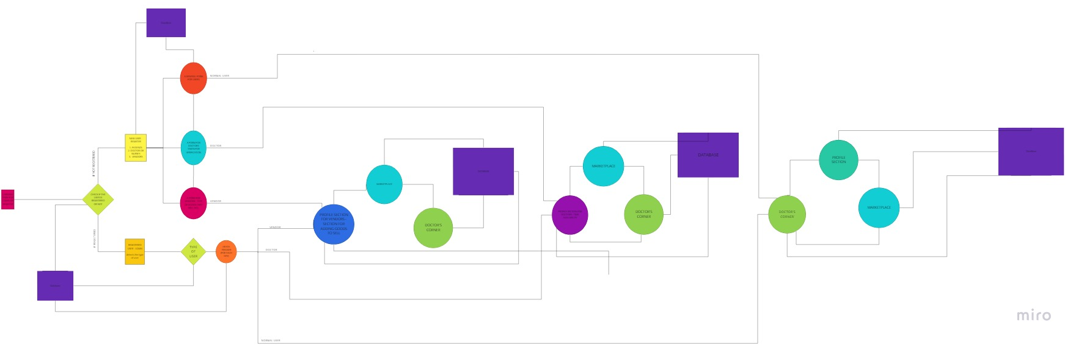
App architecture

Slide 5
Project flowchart
Collecting users data as they sign up!
Storing it in a database i.e. firebase.
Showing relevant data to the users.

Slide 6
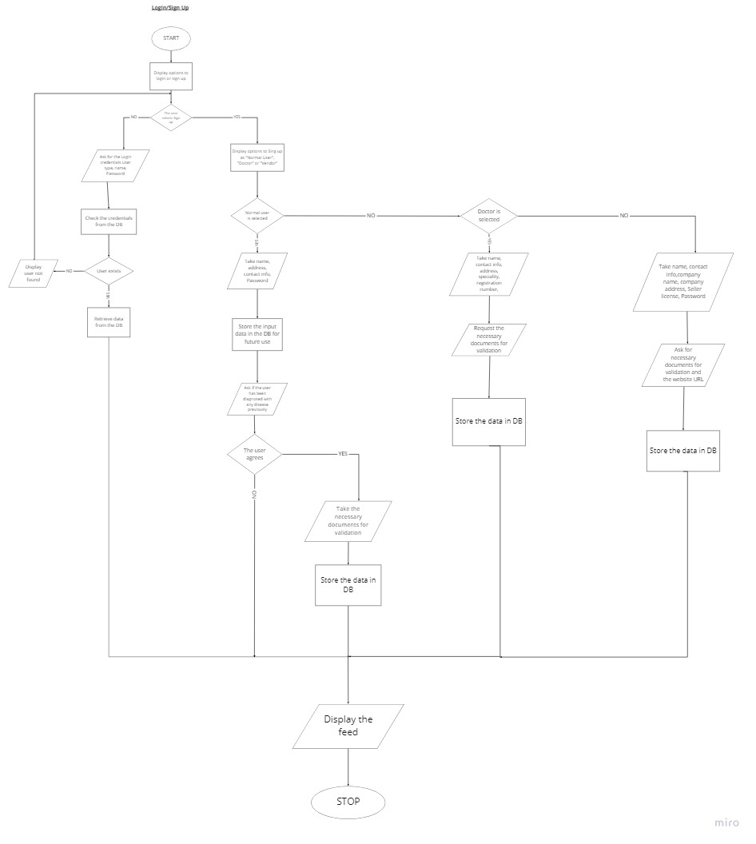
Login/signup algorithm

Slide 7
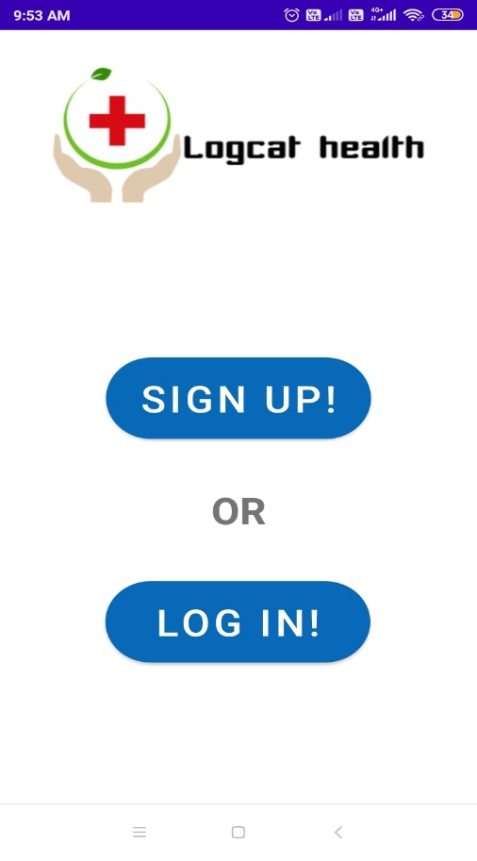
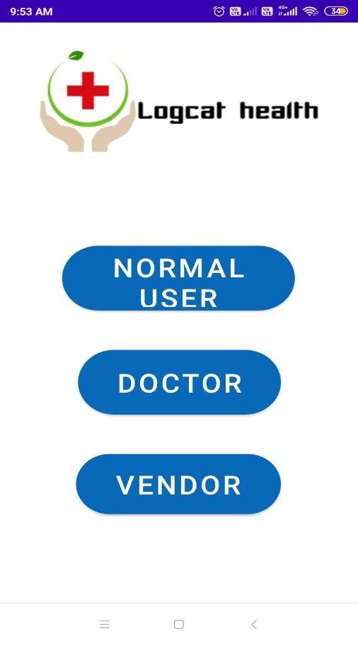
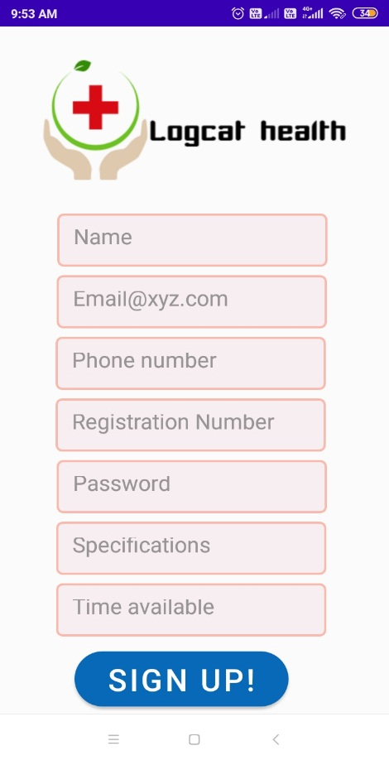
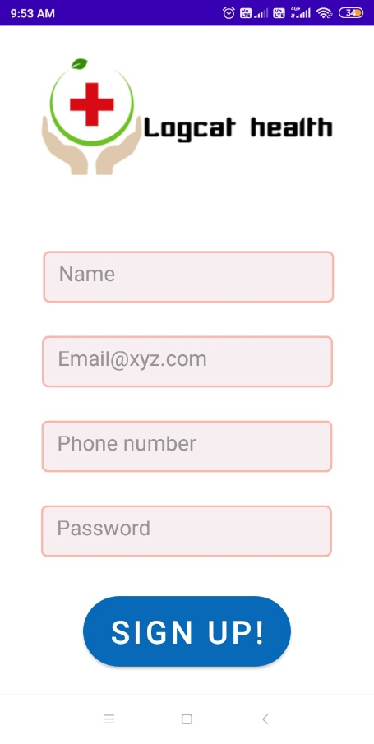
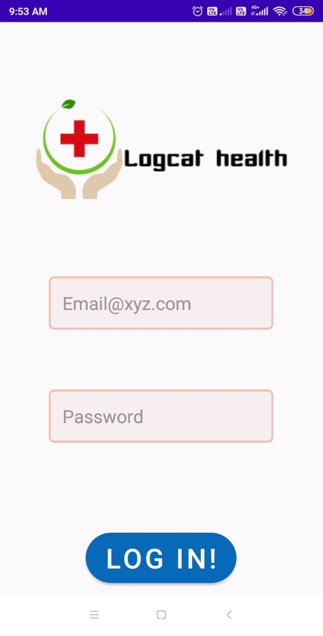
Login/Sign up screenshots
or

Slide 8
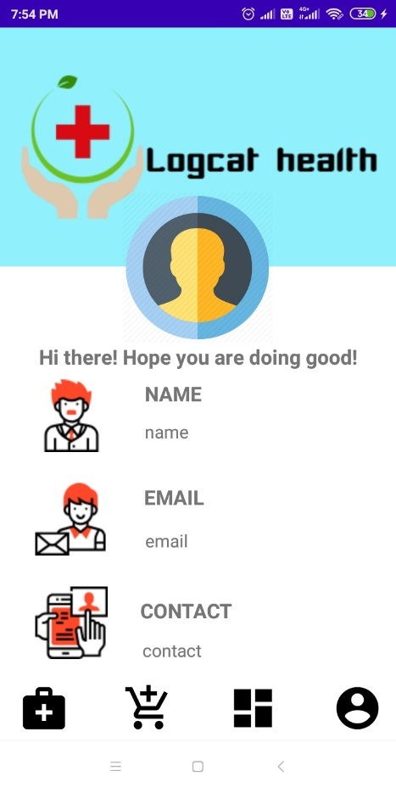
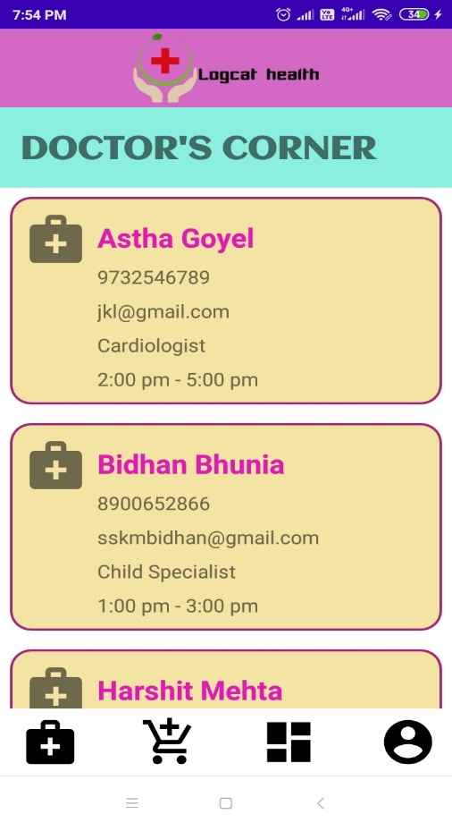
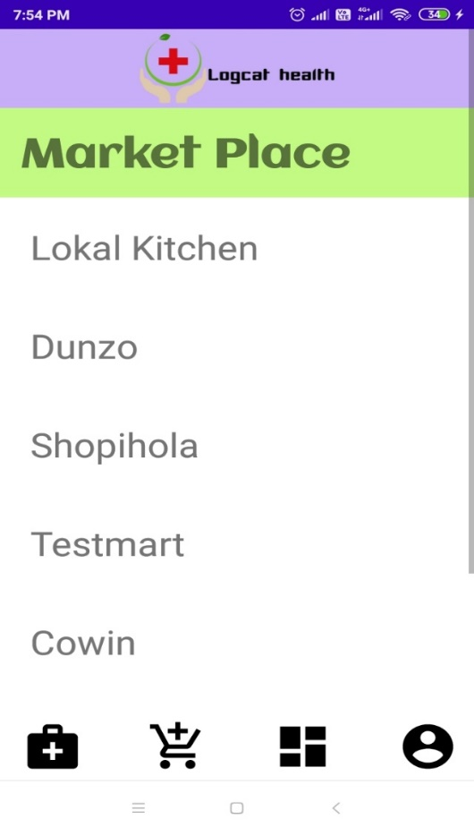
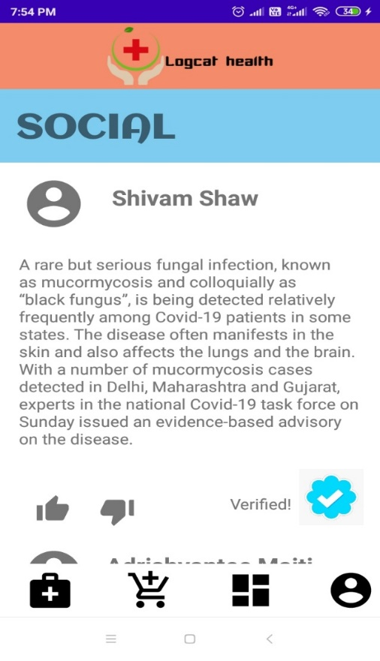
App screenshots
Profile section
Doctor’s corner
Marketplace section
Feed section

Slide 9
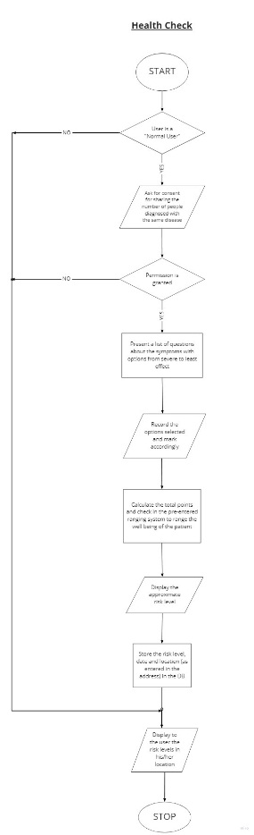
Health check algorithm

Slide 10
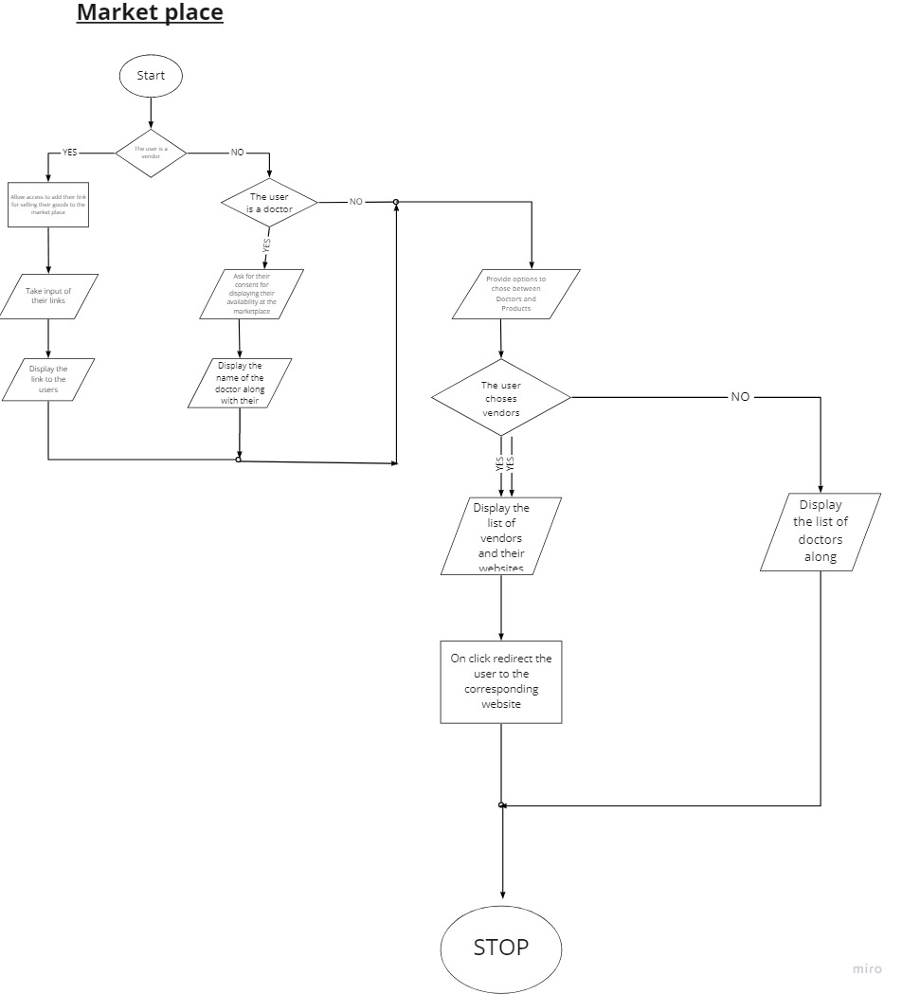
Market place
Algorithm
Demo

Slide 11
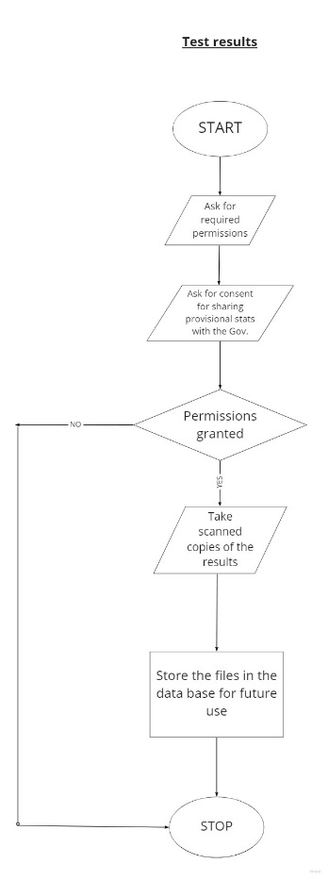
Test results algorithm

Slide 12
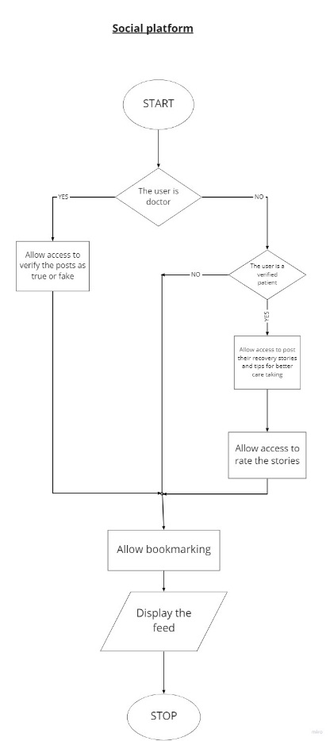
Social platform
Algorithm

Slide 13
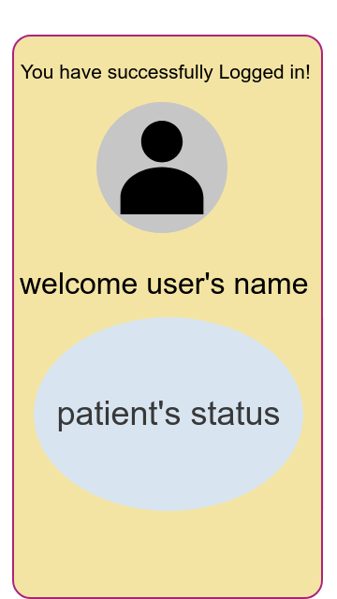
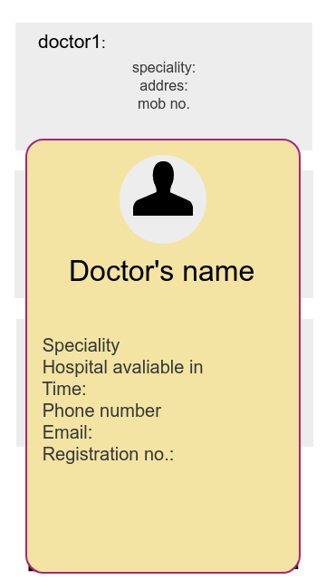
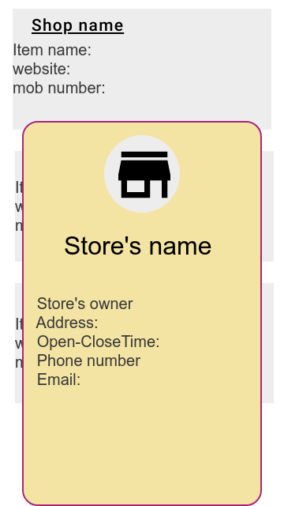
Some more app Mock-ups
Welcome screen
Card showing more doctors info
Card showing more vendor’s info

Slide 14
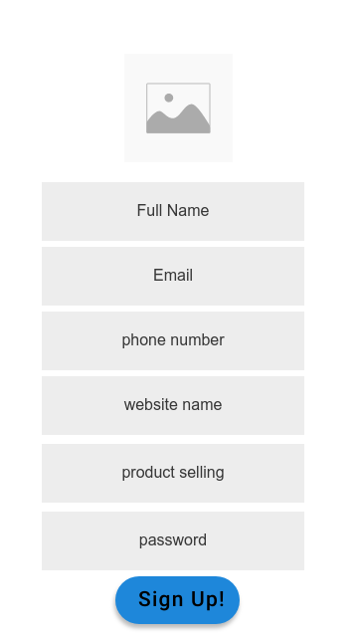
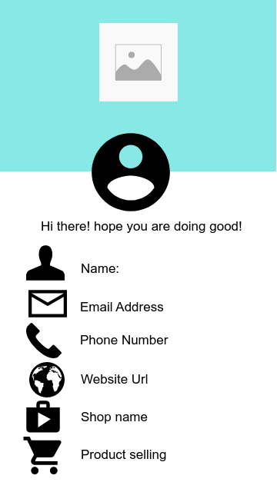
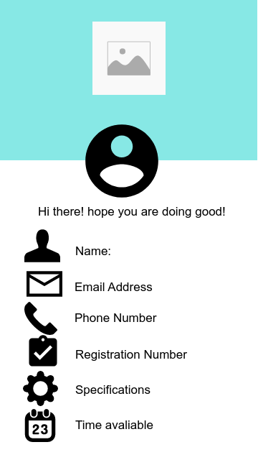
Some more app Mock-ups
Vendor’s sign up page
Vendor’s profile section
Doctor’s profile section

Slide 15
Tech Stack used
Programming language - Java
IDE - Android Studio
Database - Firebase by Google

Slide 16
Challenges Faced
Synchronization in work
Time constraints
Future Challenges to come
App is designed to be act on a production level which requires time and effort
The features needs to be updated as per users from time-to time
Future Goals
To work on our mockups and complete our first milestone - adding all the features to this app
To make it an opensource project to collaborate with other developers

Slide 17
THANK YOU!

